Slide 1
Interaction Design

Slide 2
Overview
Interaction design
is concerned with specifying the user experience for a software product
is concerned with the visual and aural appearance of the program and with the sequence of events that occur as a user and a program exchange data
Specifies both the appearance and the behavior of products.

Slide 3
Overview (cont.)
The quality of a user interface:
Effectiveness
Efficiency
Safety
Learnability
Memorability
Enjoyability
Beauty
Related fields:
Ergonomics
Perceptual physiology & psychology
Cognitive psychology
Graphic design
…

Slide 4
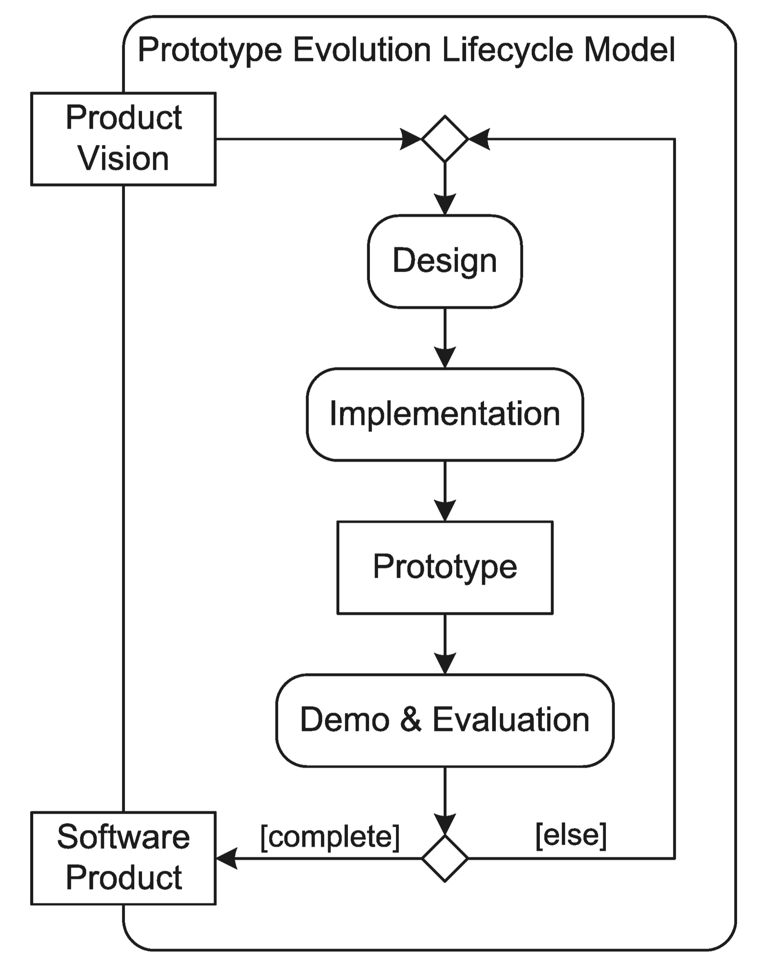
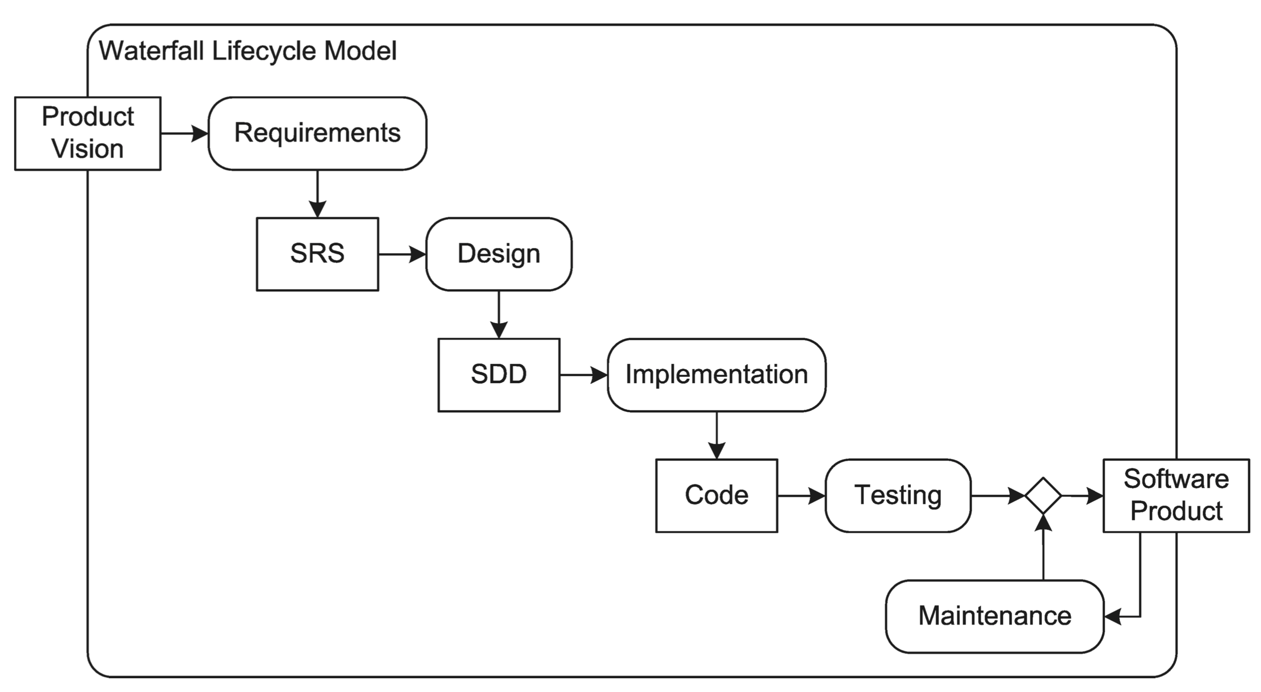
Interaction Design In the Life Cycle
In traditional approaches –
Done as an after-thought or a mini-phase between requirements specification and engineering design.
A better approach –
Use interaction design as a driver of requirements specification.
In SCRUM, interaction design should be conducted during a sprint for the features to be implemented in the following sprint.

Slide 5
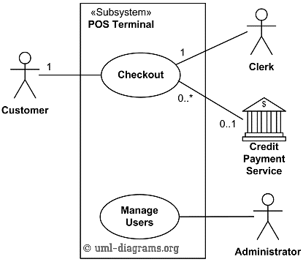
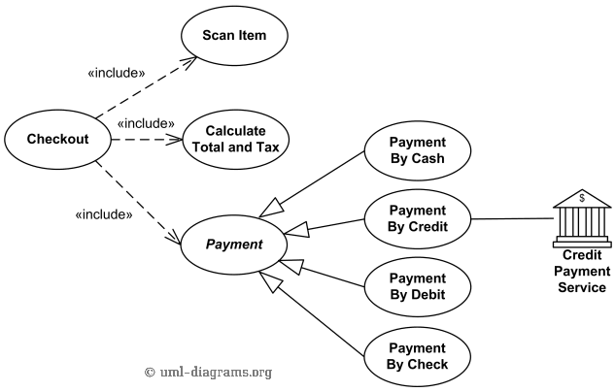
Interaction Design Models and Notations
Static model – Use case diagrams
Are an easy way to represent collection of features
Several diagrams can represent different collections of features as design alternatives

Slide 6
Static Model (cont.)
Screen (or page) layout diagrams
Drawing of (part of) a product’s visual display when it is in a particular state.
Are easy to draw and manipulate, so they are good tools for considering many design alternatives
Are a great help to stakeholders in visualizing what a product will look like
Can be drawn at various levels of abstraction
A good starting point – Wireframe
A high-fidelity diagram showing colors, fonts, controls, and so forth can be made as the basis for implementation

Slide 7
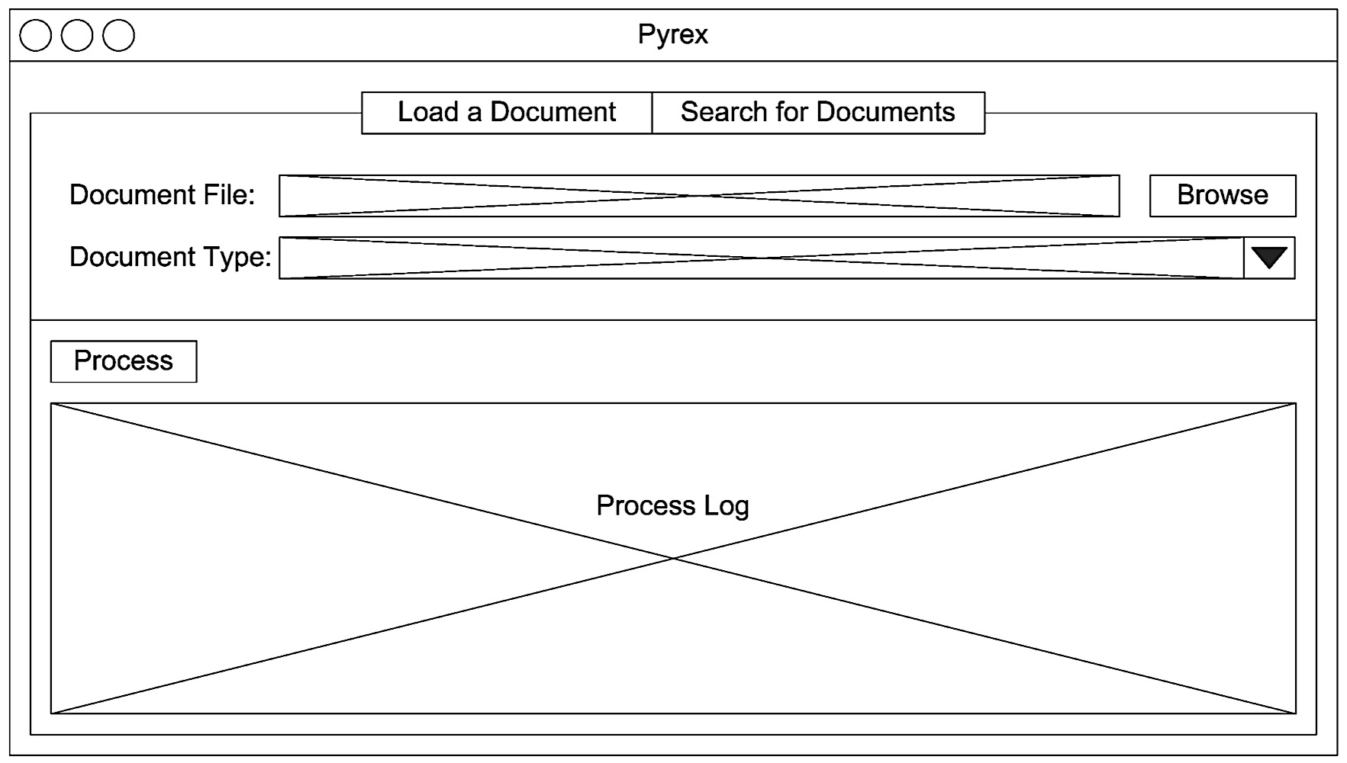
Static Model (cont.)
A Wireframe for a Screen in a Document Retrieval System

Slide 8
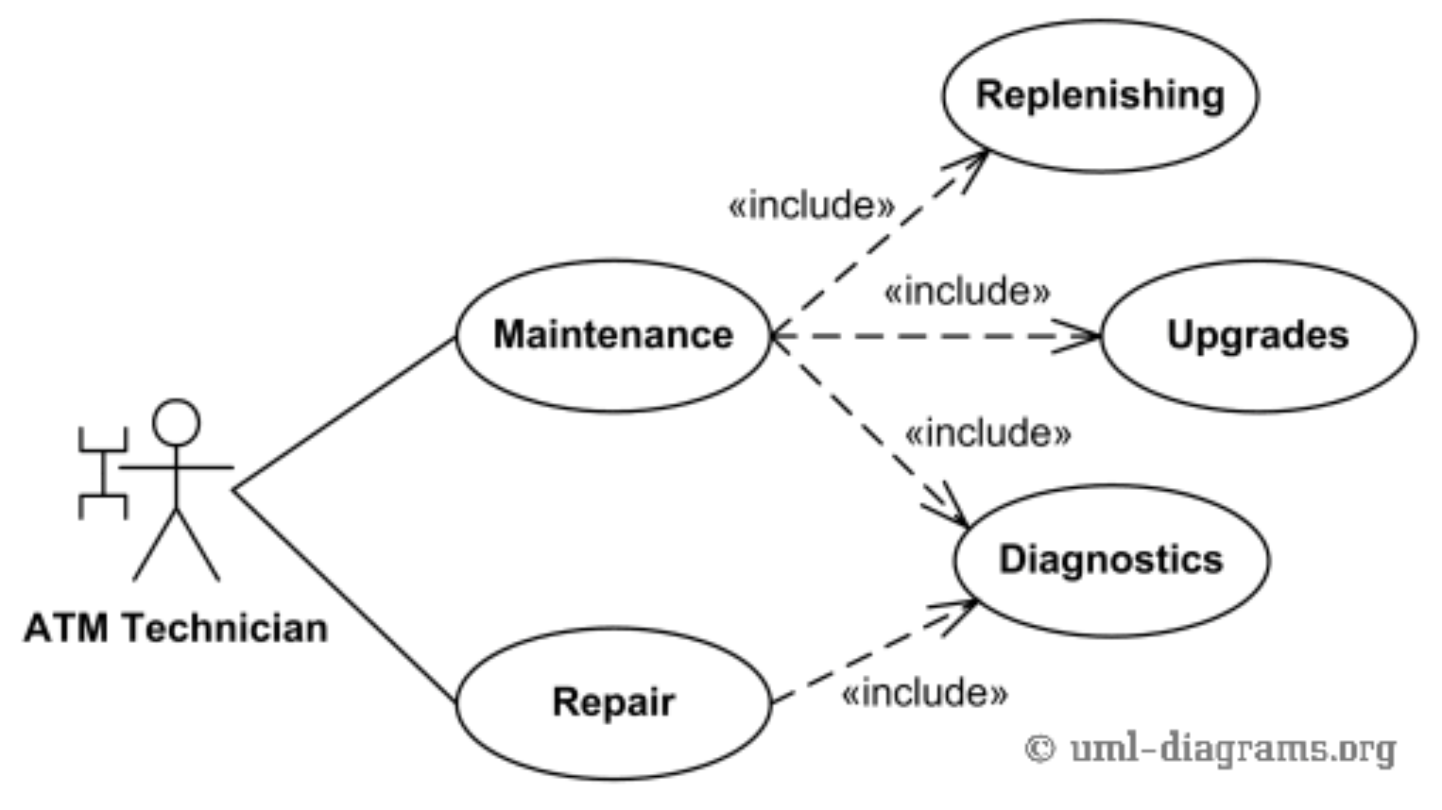
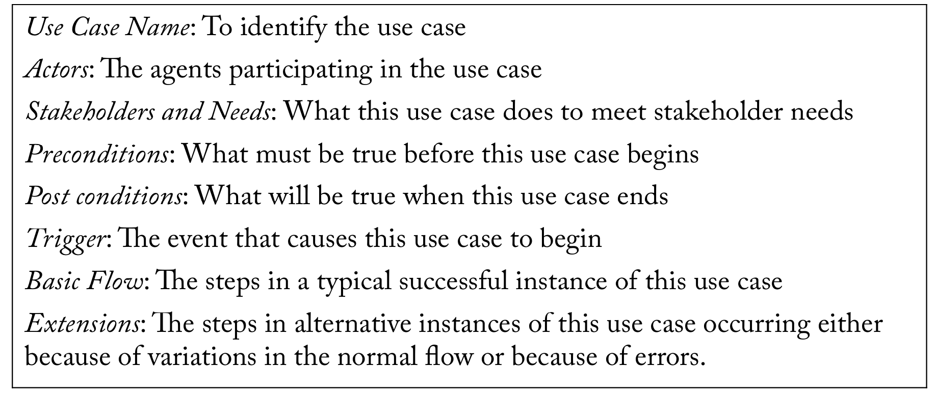
Dynamic Model
A use case description is a specification of the interaction between the product and the actors in a use case.
It provides some context information for the use case, along with a narrative resembling a script that describes the sequence of actions by actors and the product as they interact

Slide 9
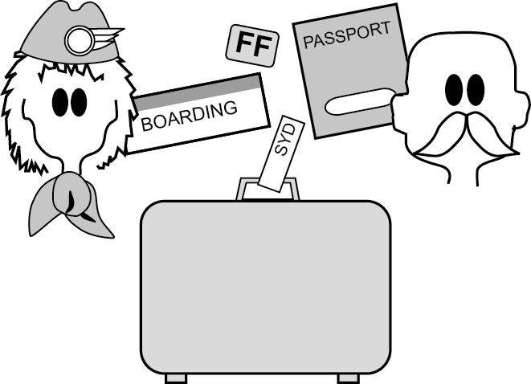
In-Class Exercise
An airline check-in for an international flight.

Slide 10
In-Class Exercise
A first draft:
1. Get the passenger’s ticket or record locator.
2. Check that this is the right passenger, flight, and destination.
3. Check that the passport is valid and belongs to the passenger.
4. Record the frequent-flyer number.
5. Find a seat.
6. Ask security questions.
7. Check the baggage onto the flight.
8. Print and hand over the boarding pass and bag tags.
9. “Have a nice flight.”

Slide 11
In-Class Exercise
A first draft:
1. Get the passenger’s ticket or record locator.
2. Check that this is the right passenger, flight, and destination.
3. Check that the passport is valid and belongs to the passenger.
4. Record the frequent-flyer number.
5. Find a seat.
6. Ask security questions.
7. Check the baggage onto the flight.
8. Print and hand over the boarding pass and bag tags.
9. “Have a nice flight.”
Business Use Case Name: Check passenger onto flight.
Trigger: Passenger’s ticket, record locator, or identity and flight.
Pre Conditions: The passenger must have a reservation and a passport.
Post Conditions: The passenger has his/her boarding pass, baggage checked-in.
Actors (Active Stakeholders): Passenger (trigger), check-in agent.
Steps:
1. Locate the passenger’s reservation.
2. Ensure the passenger is correctly identified and connected to the right reservation.
3. Check that the passport is valid and belongs to the passenger.
4. Attach the passenger’s frequent-flyer number to the reservation.
5. Allocate a seat.
6. Get the correct responses to the security questions.
7. Check the baggage onto the flight.
8. Print and convey to the passenger the boarding pass and bag tags.
9. Wish the passenger a pleasant flight.

Slide 12
Dynamic Model (cont.)
Use case descriptions can
Provide the notation for the next step in product design after choosing features.
Be used to describe the interactions realizing by each feature.
Be used to explore alternative interaction flows.
Have a big influence over many interaction design criteria, such as efficiency, safety, learnability, memorability, and enjoyability.

Slide 13
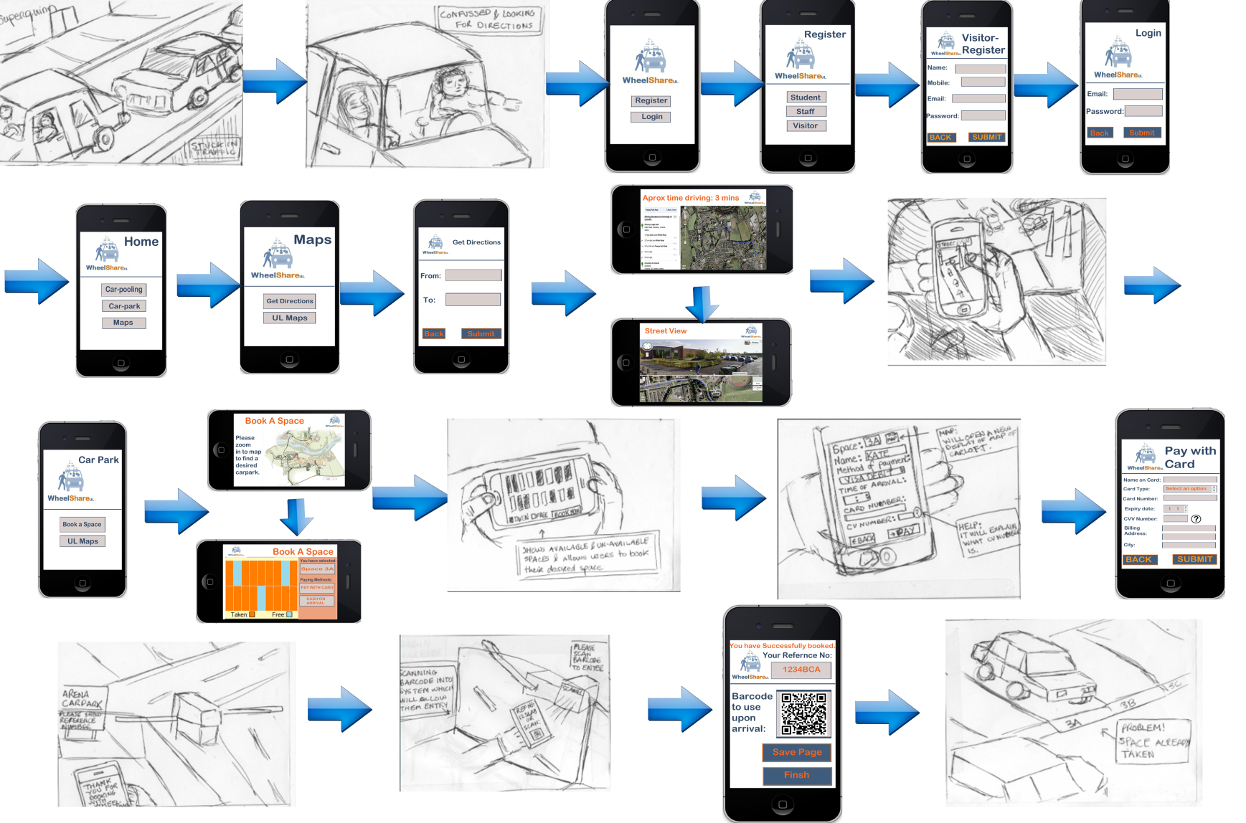
Dynamic Model (cont.)
A storyboard is a collection of screen layout diagrams linked by arrows depicting events or the passage of time.
shows how the screen changes over time or in response to various inputs
Storyboards are an excellent tool for investigating design alternatives and for helping stakeholders visualize designs before their implementation.

Slide 14
Use Case Models vs. Requirements
Should use case models be used as requirements specification?
Yes?
They can model the interactions between a system and its users and other things with which it exchanges data.
They are valuable for interaction design, and can document some requirements.
No.
They are not able to model requirements that don’t have to do with interactions.
E.g., algorithms, non-functional requirements
They are organized to trace interactions and not to specify behaviors in relation to system features.
Hence, use case models cannot capture all requirements, and they may not always be the best vehicle for expressing interaction requirements.
Notes:
Section 5 09242018
Package, library

Slide 15
Use Case Models vs. Requirements (cont.)
In SCRUM
A PBI may specify some aspect of a product’s interaction with its environment
Use case descriptions can help
capture details of interaction, and so they are a good tool for elaborating interaction PBIs during sprints.
provide supplementary information if a PBI is elaborated to a fairly low-level of detail during backlog grooming.

Slide 16
Interaction Design Processes
A top-down activity:
It begins with the most abstract models and gradually refines them until a detailed specification is complete.
A use case diagram can be formulated to pin down product features and capabilities.
Use case descriptions should follow as a means to determine the best overall flow of interaction.
Screen layout diagrams and storyboards can be made to aid in design, to obtain feedback from stakeholders, and as specifications for implementation.

Slide 17
Interaction Design Processes (cont.)
Usability testing
It is empirical evaluation of (parts of) an interaction design to determine whether it meets interaction design goals.
A testing scenario can be “executed” on anything from a rough paper prototype to a full-featured product.
Measurements:
Pre- and post- test questionnaires or surveys
Observation of user actions
How long it takes users to achieve goals
Number of user mistakes
…

Slide 18

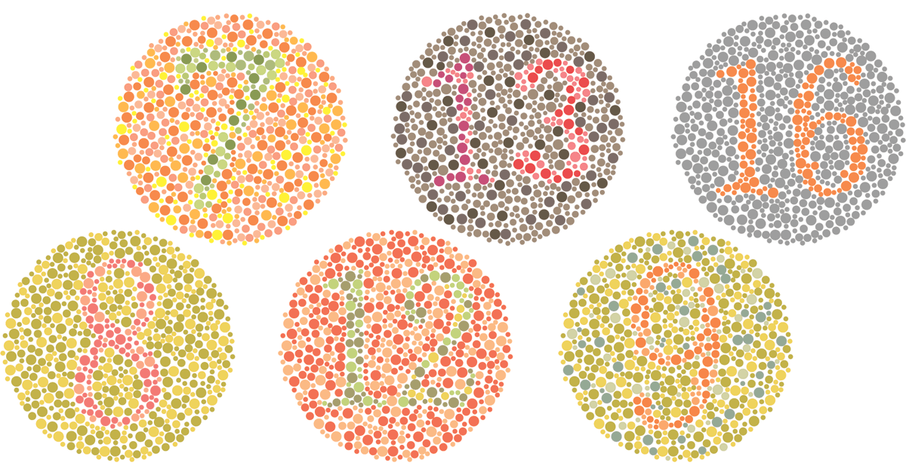
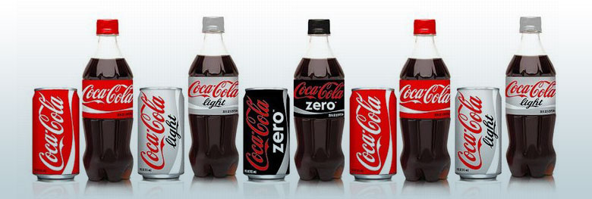
Interaction Design Principles
General principles for product appearance and behavior – SAC
Simplicity—Simpler designs are better.
Accessibility—Designs that can be used
by more people are better.
Consistency—Designs that present similar data in similar ways, and provide similar ways of accomplishing similar tasks, are better.

Slide 19
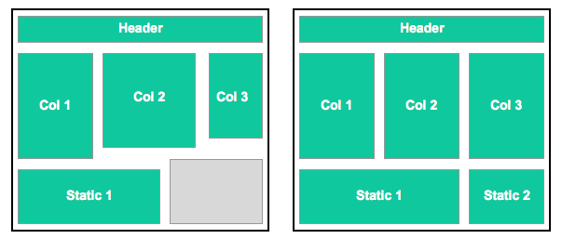

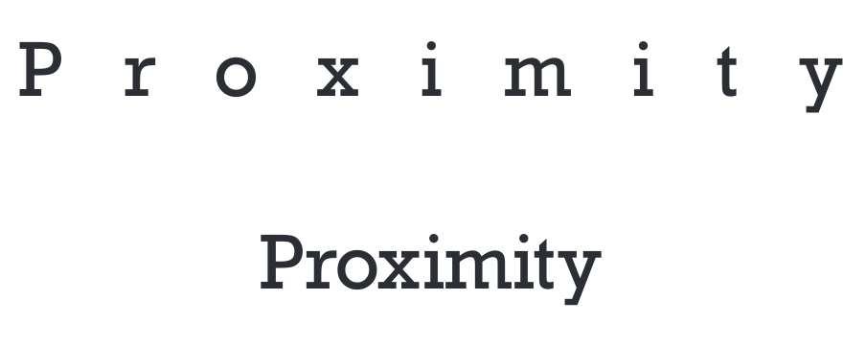
Interaction Design Principles (cont.)
Principles that apply in particular to appearance – CAP
Contrast—Designs that make things that are different appear different are better.
Alignment—Designs that line-up
elements in a grid are better.
Proximity—Designs that group related items together spatially are better.

Slide 20
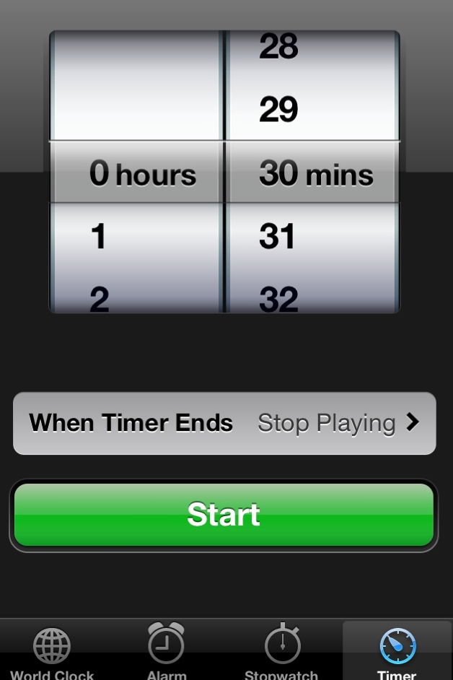
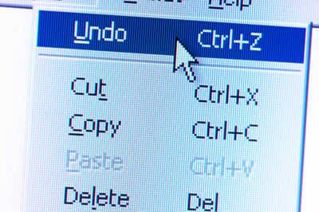
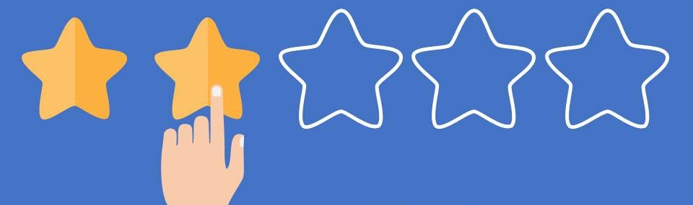
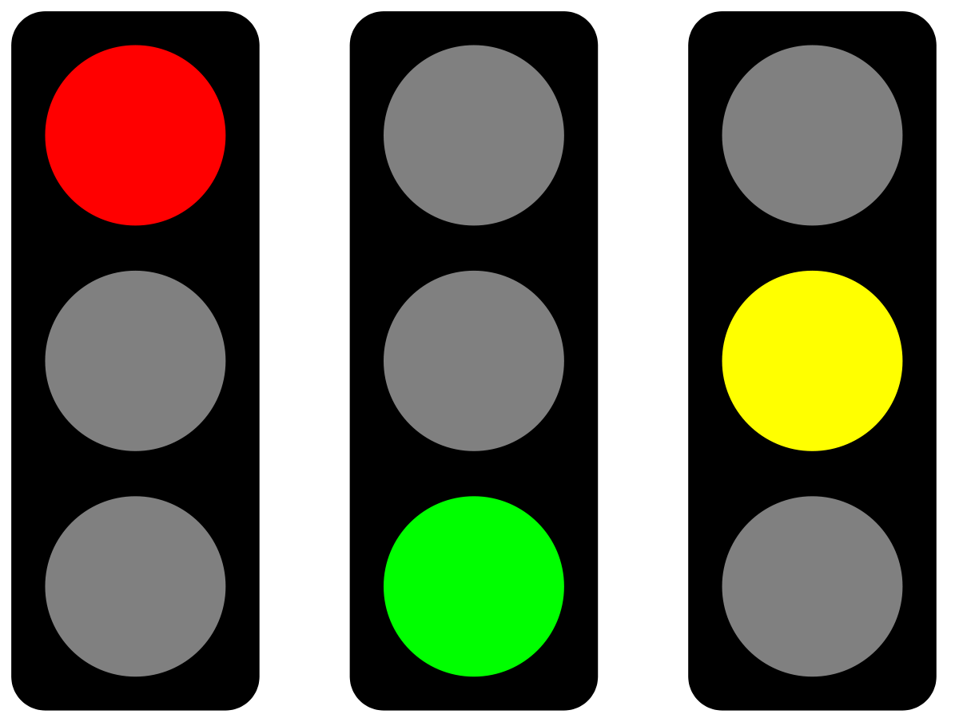
Interaction Design Principles (cont.)
Principles that apply especially to behavior – FeVER
Feedback—Designs that acknowledge user actions are better.
Visibility—Designs that prominently
display their state and available operations are better.
Error Prevention and Recovery—Designs that prevent
user errors and provide error recovery mechanisms are
better.

Slide 21
Open Discussion
The “Best” design
Does it exist?
How to evaluate a design?
Effectiveness
Efficiency
Safety
Learnability
Memorability
Enjoyability
Beauty

